Slide 1
Why is 2010 So Important?
The GOP can take seats from Pelosi
Gain strength in states for redistricting
Prepare the Party for redistricting in 2011
Set the playing field for the next 5 elections
The Winner could gain up to 20 seats – even before the election of 2012 !

Slide 2
What Needs to be Done?
Fund key Statewide and Legislative Races
Complete Election and Targeting Databases
Train GOP Stakeholders
Monitor 2010 Decennial Census Operations
Prepare For, and Execute Legal Strategy

Slide 3
How are Key Races Picked?
Chambers Within +5 to -5 Seats of Control
Statewide Officials with a Key Role
Governors
Veto Override Process
Attorneys General
Commission Members
Commission Member Appointers
Don’t Forget Unfavorable “Redistricting Reform” Initiatives

Slide 4
How are Key Races Picked?
Practicality of Electoral Success
Efficacy of Committing Funds

Slide 5
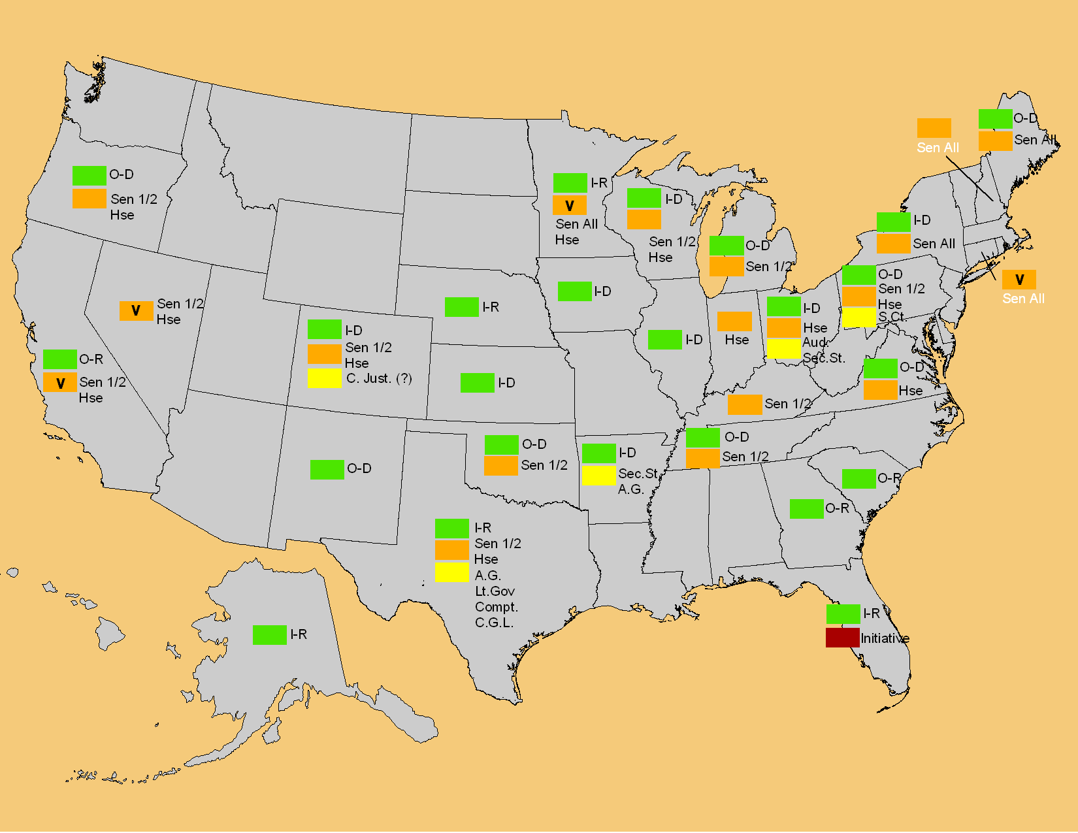

Redistricting Targets - First Cut 2009 & 2010
Governor Labels are as follows:
I-R: Republican Incumbent
I-D: Democrat Incumbent
O-R: Open Seat, Formerly Republican
O-D: Open Seat, Formerly Democrat
Current as of 7/6/09

Slide 6
Data Issues
Databases Have to be Completed
Multiple Election Years (2002 – 2010)
Election Results (Precinct by Precinct)
Registration (Voter Files)
Years Merged Together
Precinct Boundaries Change
All must be merged with Census Files
2010 Decennial Census Data
Census Mapping File (TIGER)

Slide 7
Data Issues
These are the Same Databases which Campaigns Combine with Voter ID and Commercially Available Individual Demographics for Micro Targeting
The Democrats have Created Non-Party Entities to Perform All this Work!

Slide 8
Voter Files
Democrats Use an Organization Called CATALIST to collect, format, enhance and distribute Voter List Information.
This is a Central Repository Serving as a “utility” for Democrat and Liberal Organizations.
It does not need to expend “hard” $$s.

Slide 9
Democrat Voter List Organization
DNC
Organizing for America
NCEC
Presidential
Campaigns
Democrat
Think
Tanks
CATALIST
Unions
ACT
ACORN
Advocacy Groups

Slide 10
Election History
Democrats Use an Organization Called The National Committee for an Effective Congress (NCEC) to collect, format, enhance and distribute Precinct Election History Information.
This is also a Central Repository Serving as a “utility” for Democrat and Liberal Organizations.
It does not need to expend “hard” $$s.

Slide 11
N.C.E.C.
One of the most politically active independent liberal groups, pooling contributions from across the country to help elect progressive candidates to Congress
Founded in 1948 by Eleanor Roosevelt
Advises candidates on virtually all aspects of campaigning
Worked closely with Democrats to have congressional district lines redrawn to their advantage following the 2000 census.

Slide 12
N.C.E.C.
NCEC collect, reformats and enhances precinct election history and registration databases throughout each decade.
Democrat Leadership depends on NCEC to analyze & target districts to win more GOP seats.
It is the Democrat’s primary source for all redistricting data.
Unlike GOP efforts, this NCEC remains fully funding through each entire decade.

Slide 13
FUNDING REDISTRICTING
Recent Articles Inform Us About How Democrats are Organizing For, and Funding, Their Redistricting Efforts.

Slide 14
The Democratic Redistricting Money Machine
Democratic National Committee
American Federation of
State, County &
Municipal Employees
Democratic Legislative
Campaign Committee
National Committee
for
An Effective Congress
Foundation for
The Future (527)
National Democratic Redistricting Trust

Slide 15
Making America’s Promise Secure (MAPS)
GOP Donors

Slide 16
Making America’s Promise Secure (MAPS)
GOP Donors

Slide 17
Making America’s Promise Secure (MAPS)
GOP Donors

Slide 18
Making America’s Promise Secure (MAPS)
GOP Donors

Slide 19
Making America’s Promise Secure (MAPS)
GOP Donors

Slide 20
Making America’s Promise Secure (MAPS)
GOP Donors

